Slide 1


Hariyanto
19 Feb 2025

Slide 2

Outline
Executive Summary
Introduction
Methodology
Results
Conclusion
Appendix

Slide 3
Executive Summary
We want to predict the outcome of first stage launch mission of SpaceX rockets, since this will help in saving cost.
Data was collected from SpaceX and Wikipedia. They were combined and explored to get a better sense of the data. The data was cleaned and prepared to be used in developing the predictive models.
The result shows that we can predict the outcome of launch mission by using Decision Tree Classifier

Slide 4
Introduction
In this project, we will predict if the Falcon 9 first stage will land successfully.
SpaceX advertises Falcon 9 rocket launches on its website with a cost of 62 million dollars
Other providers cost upward of 165 million dollars each
Much of the savings is because SpaceX can reuse the first stage
Problems we want to find answers:
If we can predict the ffirst stage launch outcome, we can determine the cost of the launch

Slide 5

Section 1

Slide 6
Methodology
Executive Summary
Data collection methodology:
SpaceX API
List of Falcon 9 and Falcon Heavy launches (Wikipedia)
Perform data wrangling
Perform exploratory data analysis (EDA) using visualization and SQL
Perform interactive visual analytics using Folium and Plotly Dash
Create interactive map to visualize the launch site and their proximities
Create interactive dashboard to visualize success rate
Perform predictive analysis using classification models
Using 4 model and compare the score to get the best model

Slide 7
Data Collection
Data is collected mainly from SpaceX API and Wikipedia.
API calls were made and the data is combined with the data scraped from a Wikipedia table.
Data from SpaceX API
Data from Wikipedia table
Combine data

Slide 8
Data Collection – SpaceX API
Data collection from SpaceX API:
Request and parse the SpaceX launch data using the GET request
Filter the dataframe to only include Falcon 9 launches
Dealing with Missing Values
Github URL:
https://github.com/harichang/ibmdatasciencecapstone/blob/main/jupyter-labs-spacex-data-collection-api.ipynb
Request data from API
Using GET, and then normalize json
Filter data
Only include Falcon 9
Deal with missing value
Replace missing value in Payload Mass with the mean

Slide 9
Data Collection - Scraping
Data collection from Wikipedia:
Request the Falcon9 Launch Wiki page from its URL
Extract all column/variable names from the HTML table header
Create a data frame by parsing the launch HTML tables
Github URL:
https://github.com/harichang/ibmdatasciencecapstone/blob/main/jupyter-labs-webscraping.ipynb
Scrape table
Request the Falcon9 Launch Wiki page from its URL
Extract columns
Extract all column/variable names from the HTML table header
Create dataframe
By parsing the launch HTML tables¶

Slide 10
Data Wrangling
Some Exploratory Data Analysis (EDA) is performed to find some patterns in the data and determine what would be the label for training supervised models.
Process:
Calculate the number of launches on each site
Calculate the number and occurrence of each orbit
Calculate the number and occurence of mission outcome of the orbits
Create a landing outcome label from Outcome column
Github URL:
https://github.com/harichang/ibmdatasciencecapstone/blob/main/labs-jupyter-spacex-Data%20wrangling.ipynb

Slide 11
EDA with Data Visualization
Scatter/catplot and bar chart was used to visualize the trend and relationships among variables:
Visualize the relationship between Flight Number and Launch Site
Visualize the relationship between Payload Mass and Launch Site
Visualize the relationship between success rate of each orbit type
Visualize the relationship between FlightNumber and Orbit type
Visualize the relationship between Payload Mass and Orbit type
Visualize the launch success yearly trend
Github:
https://github.com/harichang/ibmdatasciencecapstone/blob/main/edadataviz.ipynb

Slide 12
EDA with SQL
These SQL queries were performed:
Display the names of the unique launch sites in the space mission
Display 5 records where launch sites begin with the string 'CCA’
Display the total payload mass carried by boosters launched by NASA (CRS)
Display average payload mass carried by booster version F9 v1.1
List the date when the first succesful landing outcome in ground pad was acheived.
List the names of the boosters which have success in drone ship and have payload mass greater than 4000 but less than 6000
List the total number of successful and failure mission outcomes
List the names of the booster_versions which have carried the maximum payload mass. Use a subquery
List the records which will display the month names, failure landing_outcomes in drone ship ,booster versions, launch_site for the months in year 2015.
Rank the count of landing outcomes (such as Failure (drone ship) or Success (ground pad)) between the date 2010-06-04 and 2017-03-20, in descending order.
Github:
https://github.com/harichang/ibmdatasciencecapstone/blob/main/jupyter-labs-eda-sql-coursera_sqllite.ipynb

Slide 13
Build an Interactive Map with Folium
Folium map built to visualize the location and proximities:
Mark all launch sites on a map
Mark the success/failed launches for each site on the map
Calculate the distances between a launch site to its proximities:
Coastline
Railway
Highway
City
Some proximities were added to get a better sense of the surrounding of the launch site.
Github:
https://github.com/harichang/ibmdatasciencecapstone/blob/main/lab_jupyter_launch_site_location.ipynb

Slide 14
Build a Dashboard with Plotly Dash
The Plotly-Dash dashboard were created:
Pie chart to show the total successful launches count for all sites or for each site selected
Scatter chart to show the correlation between payload and launch success for all sites or for each site
Dropdown list to select Launch Site
Range Slider to select Payload range
The dropdown and range slider is necessary so the user can choose/filter the the data for the charts.
Github:
https://github.com/harichang/ibmdatasciencecapstone/blob/main/spacex_dash_app.py

Slide 15
Predictive Analysis (Classification)
Steps in the predictive analysis:
Load data into X (features) and Y (target)
Standarize the data
Split the data with 20% test data
Train the model using Grid Search on four methods:
Logistic Regression
SVM
Decision Tree Classifier
KNN
Compare the accuracy score on training and test data to determine the best model
Github:
https://github.com/harichang/ibmdatasciencecapstone/blob/main/SpaceX_Machine%20Learning%20Prediction_Part_5.ipynb
Load data
Standardize data
Split data
Train model
Compare model scores

Slide 16
Results
Exploratory data analysis results
From the exploratory analysis, we can see the relationship among variables.
But we cannot conclude the main factor affecting the mission outcomes.
Predictive model were needed to predict mission outcomes.
Predictive analysis results:
Four models were trained: Logistic Regression, SVM, Decision Tree Classifier, and KNN
The best predictive model is Decision Tree Classifier.

Slide 17

Section 2

Slide 18
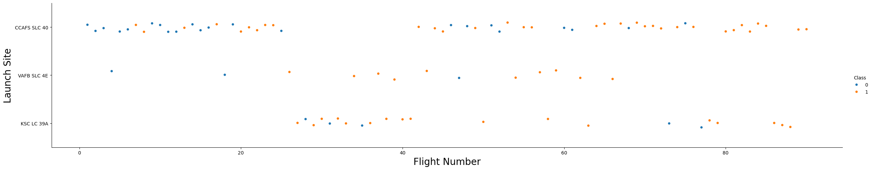
Flight Number vs. Launch Site
The scatter plot shows that there is no correlation between launch site and flight number.
It shows that higher flight numbers have more successful landing.

Slide 19
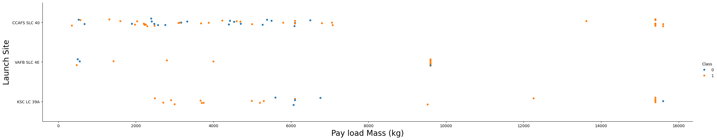
Payload vs. Launch Site
The scatter plot shows that there is no correlation between launch site and payload mass
It shows that higher payload mass might have more successful landing, but need further analysis.

Slide 20
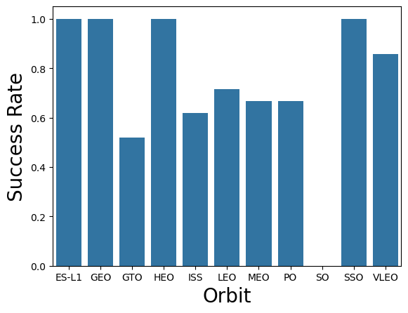
Success Rate vs. Orbit Type
Each orbit type have different success rate:
Orbit type ES-L1, GEO, HEO, and SSO have 100% success rate.
Other orbit types have around 60% success rate.
GTO orbit type has 50% success rate
SO orbit type has 0% success rate

Slide 21
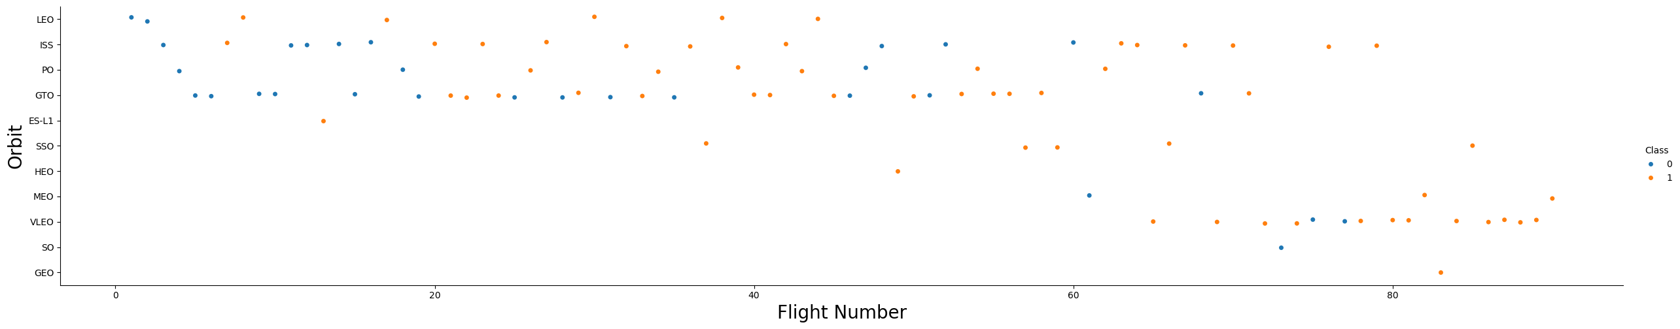
Flight Number vs. Orbit Type
The scatter plot shows that certain orbit types have higher flight number.
It also shows that higher flight number might have more successful landing.

Slide 22
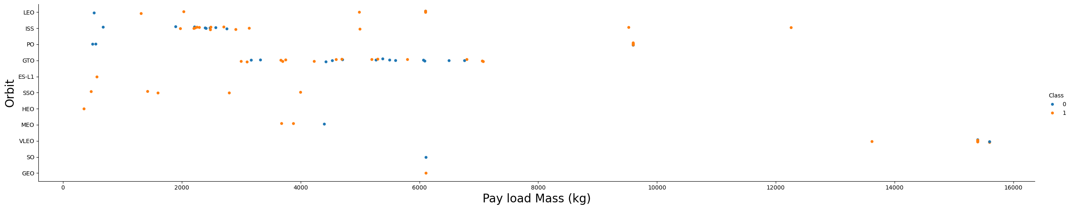
Payload vs. Orbit Type
The scatter plot shows that certain orbit types handles higher payload mass.
It shows that most payload mass are around 2000 an 7000 kg.

Slide 23
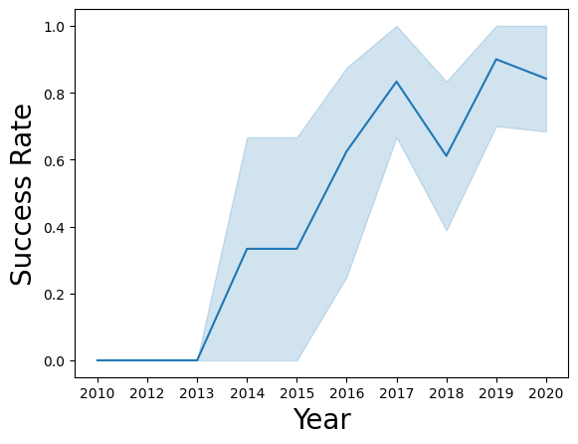
Launch Success Yearly Trend
From 2013, success rate kept increasing.
Since then, the lowest success rate was in 2018.
And the highest success rate was in 2019.

Slide 24
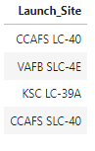
All Launch Site Names
The names of the unique launch sites:
There are only 4 unique launch site in the data

Slide 25
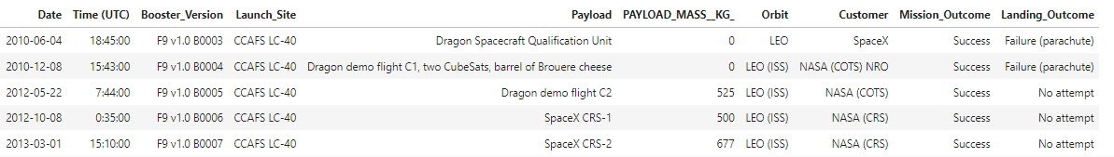
Launch Site Names Begin with 'CCA'
5 records where launch sites begin with `CCA`:
The first lauch from site ‘CCAFS LS-40’ is from year 2010

Slide 26
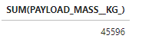
Total Payload Mass
The total payload carried by boosters from NASA:
Total Payload mass for customer NASA is 45,596 kg.

Slide 27
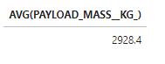
Average Payload Mass by F9 v1.1
The average payload mass carried by booster version F9 v1.1:
Average payload mass carried by booster version F9 v1.1 is 2928.4 kg

Slide 28
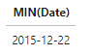
First Successful Ground Landing Date
The date of the first successful landing outcome on ground pad:
The first successful landing on ground pad is on 22 Dec 2015

Slide 29
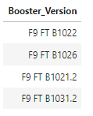
Successful Drone Ship Landing with Payload between 4000 and 6000
Names of boosters which have successfully landed on drone ship and had payload mass greater than 4000 but less than 6000:
There are only 4 booster version with payload between 4000 and 600 that had successfully landed on drone ship.

Slide 30
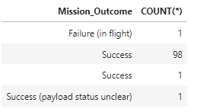
Total Number of Successful and Failure Mission Outcomes
Total number of successful and failure mission outcomes:
Most mission are successful with only one mission had failure as outcome.

Slide 31
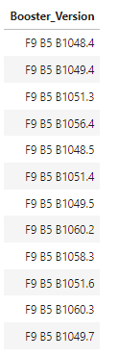
Boosters Carried Maximum Payload
Names of the booster which have carried the maximum payload mass:
There are 12 booster version that carried the maximum payload mass

Slide 32
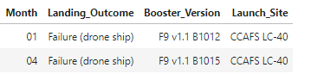
2015 Launch Records
Failed landing_outcomes in drone ship, their booster versions, and launch site names for in year 2015:
There are two failed landing outcome in drone ship in year 2015

Slide 33
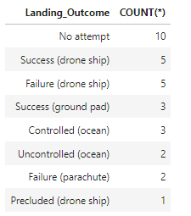
Rank Landing Outcomes Between 2010-06-04 and 2017-03-20
Rank of count of landing outcomes between the date 2010-06-04 and 2017-03-20, in descending order:
Ten missions between 2010-06-04 and 2017-03-20 had no landing attempt.
Ten mission had drone ship landing attempt, with only half were successful

Slide 34

Section 3

Slide 35
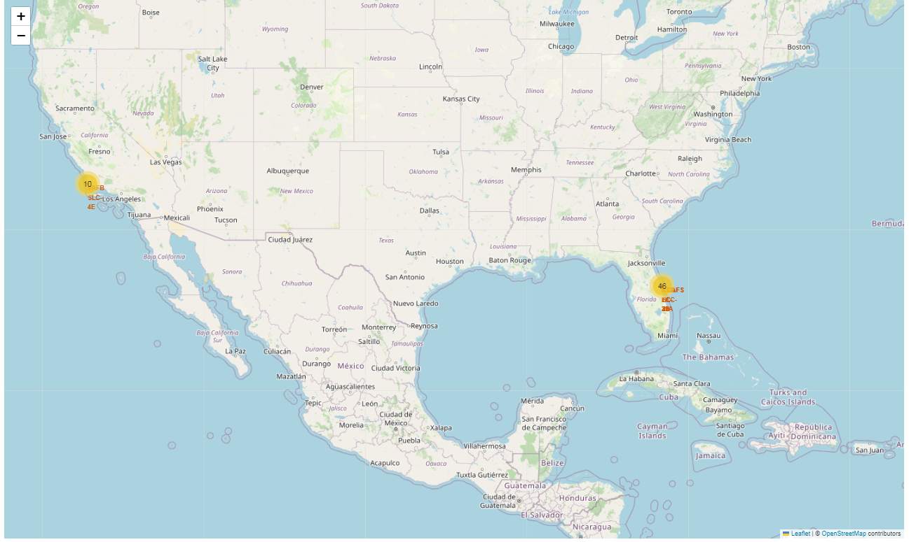
Map of Lauch Sites
The map shows all launch site locations.
Most launches were from the east cost.

Slide 36
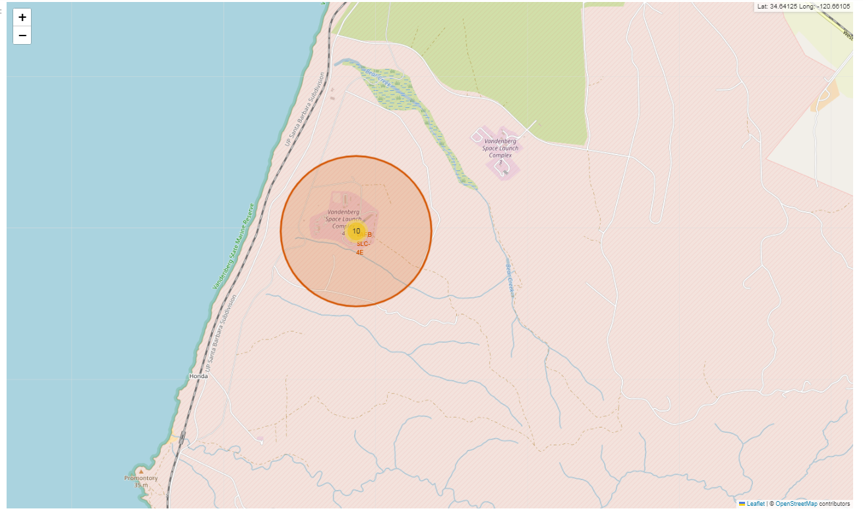
Map of Launch Outcomes
The map shows launch site locations on west coast.

Slide 37
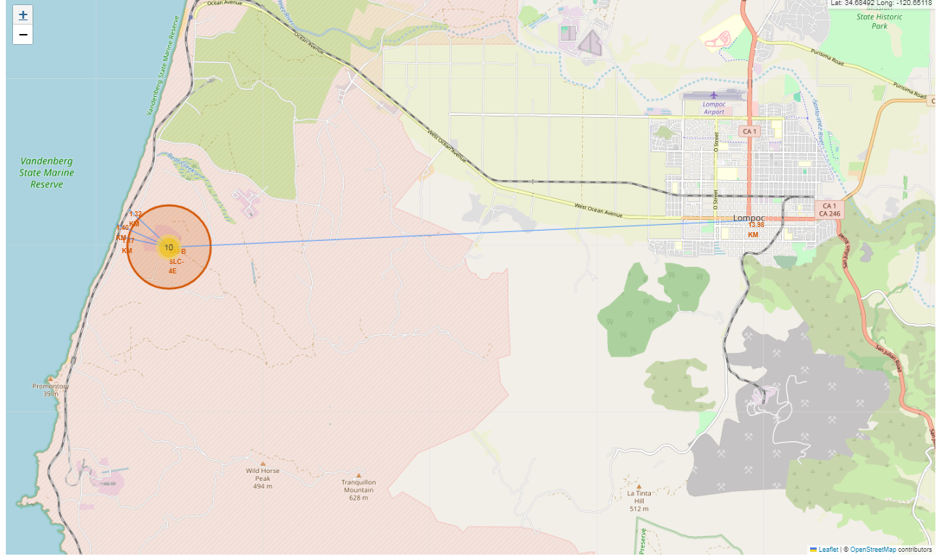
Map of proximity distances from a Launch Site
The map shows the point of proximities from one launch site and their distances:
Coastline
Railway
Highway
City

Slide 38

Section 4

Slide 39
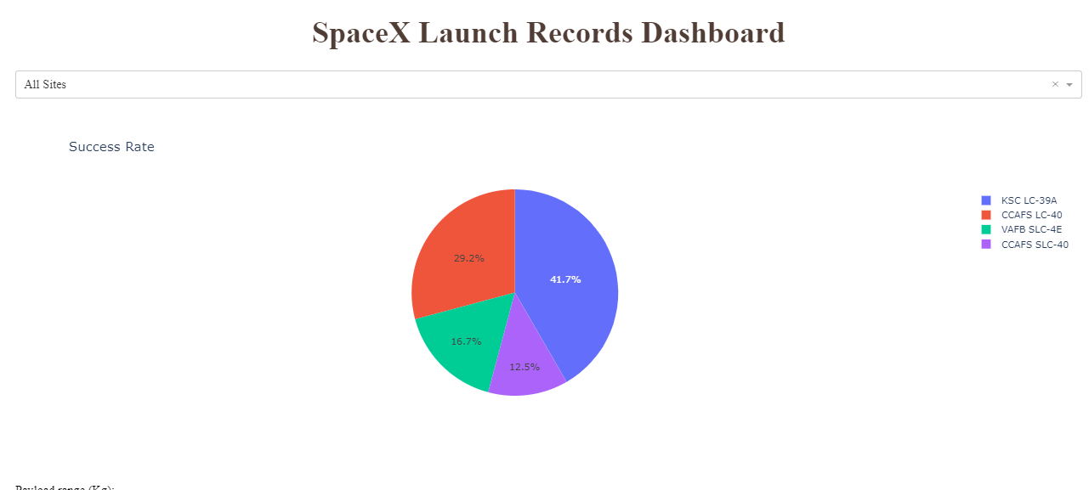
Launch Success Count for All Sites
KSC LC-39A is the launch site with the most success count.
CCAFS SLC-40 is the launch site with the least success count.

Slide 40
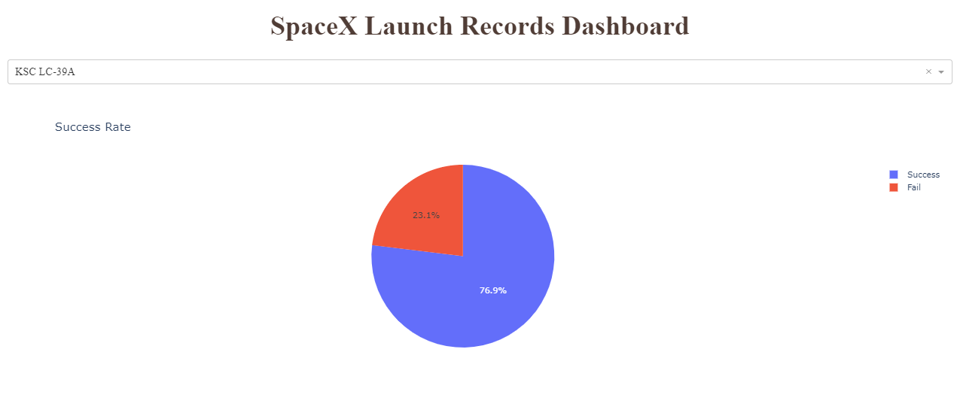
Launch Site with Highest Launch Success Ratio
KSC LC-39A is the launch site with the most success count.
Ten launches were successful
Only 3 launches failed

Slide 41
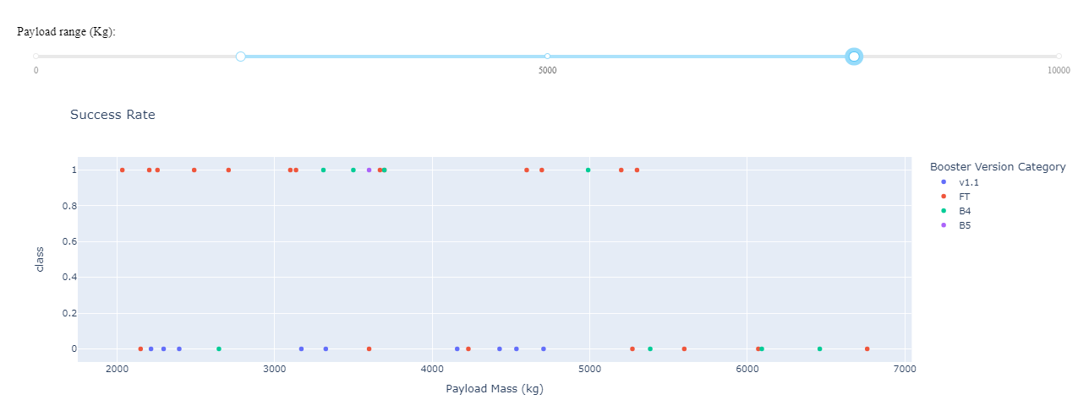
<Dashboard Screenshot 3>
The most successful launches were with payload between 2000 and 6000
Booster version category v1.1 had the most failures.
Booster version category FT had the most successes.

Slide 42

Section 5

Slide 43
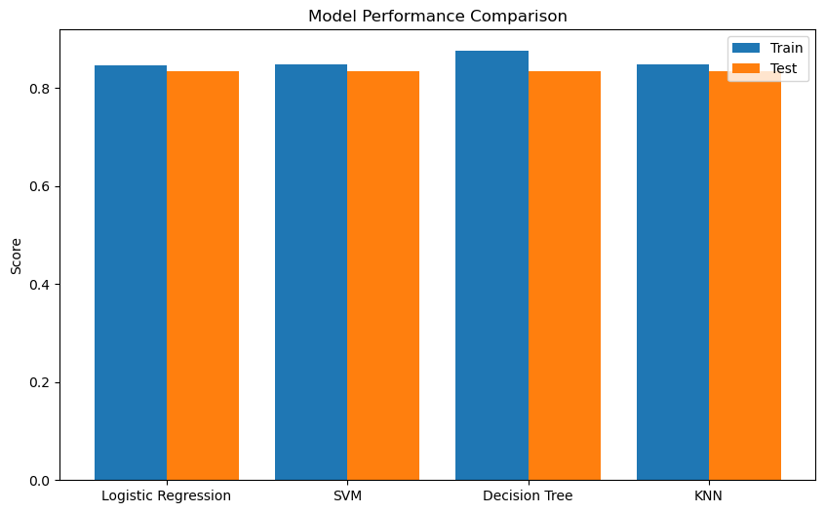
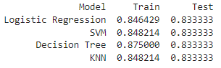
Classification Accuracy
Decision Tree Classifier has the highest accuracy score:

Slide 44
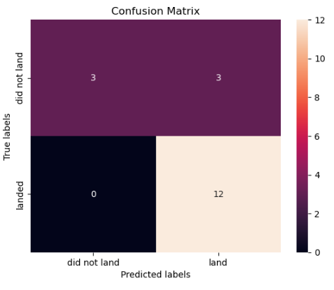
Confusion Matrix
The confusion matrix of the Decision Tree Classifier shows that it correctly predicted 12 of all 12 successful landing.
Accuracy: 15/18 = 83.33%
Precision: 12/15 = 80%
Recall: 12/12 = 100%

Slide 45
Conclusions
The best model to predict successful landing is Decision Tree Classifier, with accuracy score of 83.33% (87.5% on training data)
The best parameter for this model are:
'criterion': 'gini’
'max_depth’: 2
'max_features': 'sqrt’
'min_samples_leaf’: 4
'min_samples_split’: 2
'splitter': 'random'

Slide 46
Appendix
List of Falcon 9 and Falcon Heavy launche:
https://en.wikipedia.org/wiki/List_of_Falcon_9_and_Falcon_Heavy_launches
Project Github URL:
https://github.com/harichang/ibmdatasciencecapstone

Slide 47


